Slide 1




Amazon Sales Data Pipeline
DSCI-6007-Distributed and Scalable Data Engineering
Team - 11
Professor - Ardiana Sula

Slide 2





MEET THE TEAM
Shivani Shivalenka
Shruti Bandula
Rajesh Yatham
Sravanthi

Slide 3

Problem statement
Amazon collects a lot of sales data every day from different sources and in various formats. They need quick insights to make decisions in real-time or near-real-time. The traditional data processing methods they use are slow and prone to errors. Their current system can't handle the increasing data volumes effectively and lacks the flexibility needed. This makes it hard for them to get timely insights and impacts their decision-making processes.

Slide 4

Business Understanding
Analyzing sales data plays a crucial role in Amazon's decision-making process. By examining sales figures, Amazon can identify consumer trends, improve pricing strategies, and customize marketing campaigns. This strategic use of sales data promotes operational efficiency, improves customer satisfaction, and strengthens revenue generation

Slide 5

Data Understanding
The dataset contains 1K+ Amazon product ratings and reviews.
Features include product ID, name, category, price details, rating, user information, review details, and links to product images and official website.
Source - https://www.kaggle.com/datasets/karkavelrajaj/amazon-sales-dataset

Slide 6

Proposed Solution
To address these challenges, we propose building an automated sales analysis data pipeline on AWS using Apache Airflow. This pipeline will streamline the ingestion, transformation, and analysis of sales data, ensuring its accuracy, consistency, and availability for stakeholders. By leveraging Apache Airflow's workflow orchestration capabilities and AWS services such as S3 for storage, Glue for data transformation, and Athena for querying, the solution will automate the end-to-end process, enabling real-time insights, data-driven decision-making, and business agility

Slide 7

ETL Pipeline
Extract:
Kaggle or manual download for obtaining CSV data
Transform:
Python (with libraries like Pandas) for data transformation and processing.
Load:
Amazon S3 for storing both raw and processed data.
Amazon Redshift for loading processed data into a data warehouse.

Slide 8
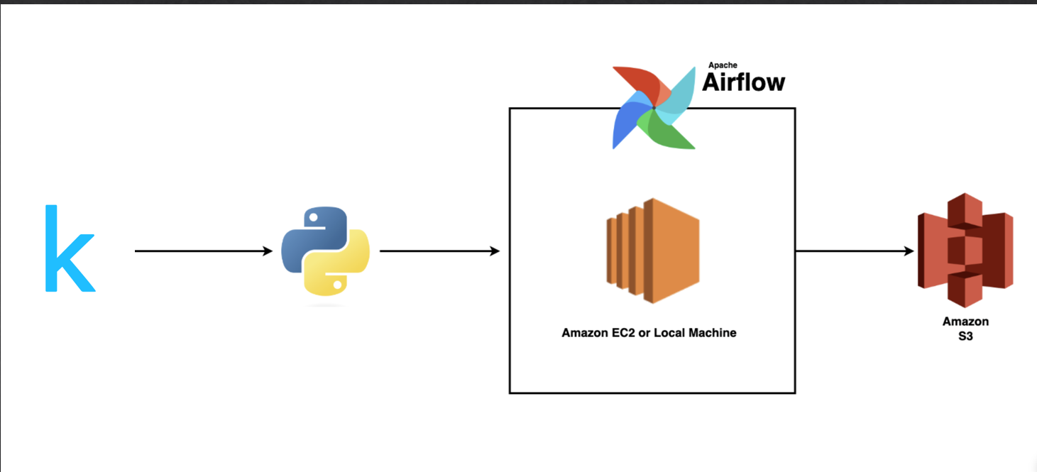
The Approach
Set up Apache Airflow on an AWS EC2 instance.
Define the DAG for the ETL pipeline using Python in Airflow.
Configure connections to AWS S3 and Redshift in Airflow.
Define tasks within the DAG to:
Extract the data from the CSV file.
Transform the data using Python scripts or SQL queries.
Load the transformed data into AWS Redshift.
Schedule the DAG to run at regular intervals.

Slide 9

Conclusion
In summary, the Amazon sales data pipeline, powered by Apache Airflow and AWS services, may provide actionable insights into sales trends and customer behavior. These insights will enable informed decision-making, leading to improved business performance.

Slide 10

Github Repo
https://github.com/DSDE-Team-11/AmazonDataPipeline

Slide 11

THANK YOU

